Slide 1


CHM 103 ORGANIC CHEMSTRY I
Department of Chemical Sciences
Faculty of Science and Technology
Bingham University, Karu
Course Lecturer: Joseph C. Oguegbulu
Joseph.oguegbulu@binghamuni.edu.ng

Slide 2
COURSE CONTENT
Introduction. History, classifications 0.5 week
Carbon: Bonding in organic compounds, structure 0.5 week
Functional groups 0.5 week
IUPAC nomenclature 1 week
Isomerism – Structural & Stereo-isomerism 2 weeks
Hybridisation – Resonance effects & others 2 weeks
Alkanes, Alkenes, Alkynes 1.5 weeks
Alkyl halides, Alkanols 1 week
Carbonyl compounds: Alkanals and Alkanones. 0.5 week

Slide 3
CHM 103 ORGANIC CHEMSTRY I
Department of Chemical Sciences
Faculty of Science and Technology
Bingham University, Karu
Course Lecturer: Joseph C. Oguegbulu
Joseph.oguegbulu@binghamuni.edu.ng

Slide 4
LECTURE V
ISOMERISM
STRUCTURAL ISOMERISM
Chain
Position and
Functional Group Isomerism

Slide 5

OBJECTIVES: At the end, you should be able to…
Apply IUPAC rules to naming simple and semi-complex compounds
Show the structural formulars of cmpds based on their IUPAC names
Explain isomerism and its types
Differentiate between structural and stereo-isomerism
Differentiate & show e.g. of various types of structural isomerism

Slide 6
ISOMERISM
The existence of compounds with same molecular formula but different structural formulas
Types
Structural/Constitutional Isomerism: Same constitution, different connectivities
Stereoisomerism: Same constitution, same connectivities, different spatial arrangements (spatial orientation)

Slide 7
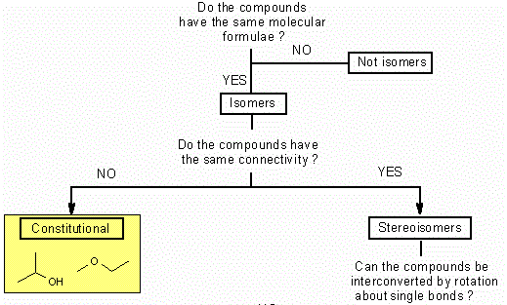
ISOMERISM

Slide 8
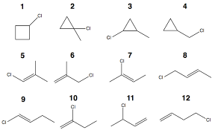
STRUCTURAL ISOMERISM
Also called constitutional isomerism
All these cmpds have the same molecular formula:
What is it?
Types:
Chain Isomerism
Position Isomerism
Functional Group Isom.
C₄H₇Cl

Slide 9
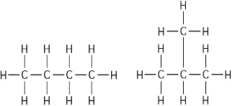
CHAIN ISOMERISM (Struct. Iso. Types)
Two compounds can have different chains or branching
Also called branching Isomerism
Examples…
Butane & 2-Methylbutane
3-ethyl,5-methylheptane & Decane
Cyclohexane & methylcyclopentane
Q5: Show all the chain isomers of hexane (C₆H₁₄) Name them???
Butane
(n-Butane)
2-Methylpropane
(Isobutane)

Slide 10
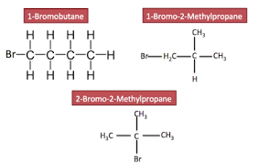
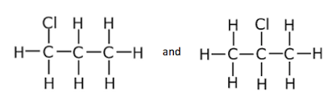
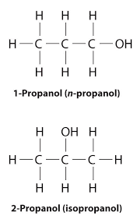
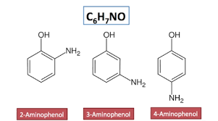
POSITION ISOMERISM (Struct. Iso. Types)
Just like in chain isomerism but when other elements are present
Examples…
C₄H₉Br
C₃H₇Cl
C₃H₇OH
C₆H₄NH₂OH
Q6
C₅H₉Br (take home)
Chloropropane
2-Chloropropane

Slide 11
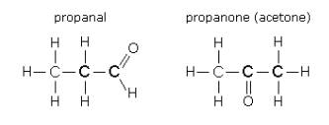
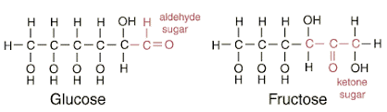
FUNCTIONAL GROUP ISO (Struct. Iso. Types)
A new functional group may form bc of change in position of an atom
Examples…
Aldehydes and ketones
E.g. propanal and propanone
Aldoses vs Ketoses
eg Glucose vs Fructose
Keto/Enol Tautomerism
e.g. Butan-2-one and But-3-en-2-ol
OR
3-Hydroxybutene

Slide 12

TUTORIAL 5: Structural Isomerism
Q7
Show any functional group isomers of propanoic acid (C₃H₆O₂)

Slide 13
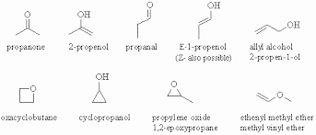
TUTORIAL 5: Structural Isomerism
Q8
Show ALL the possible isomers of C₃H₆O

Slide 14


Slide 15
CHM 103 ORGANIC CHEMSTRY I
Department of Chemical Sciences
Faculty of Science and Technology
Bingham University, Karu
Course Lecturer: Joseph C. Oguegbulu
Joseph.oguegbulu@binghamuni.edu.ng

Slide 16
LECTURE VI
STEREOISOMERISM
CONFORMATIONAL ISOMERISM
CIS/TRANS (or GEOMETRIC ISOMERISM)
OPTICAL ISOMERISM
ENANTIOMERISM
DIASTEREOMERISM
MESOMERS
RACEMIC MIXTURES
SOME IMPORTANT CHIRAL COMPOUNDS IN NATURE

Slide 17
OBJECTIVES: At the end, you should be able to…
Appreciate the three dimensional orientation of atoms in a stereoisomer
Explain conformations
Differentiate b/w conformational and configurational isomerism
Explain cis/trans ism with examples
Explain chirality and optical iso with e.g.
Differentiate between enantiomers and diastereomers
Explain Mesomers, recemisation, etc

Slide 18
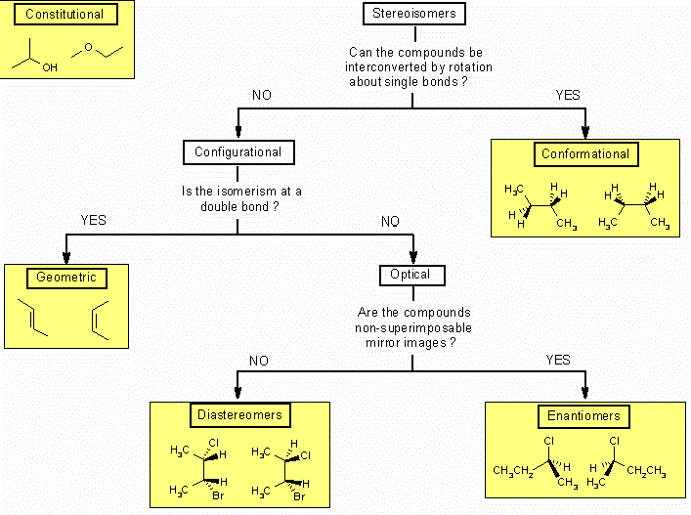
STEREOISOMERISM
D

Slide 19
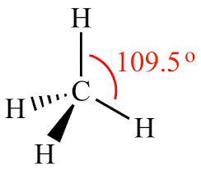
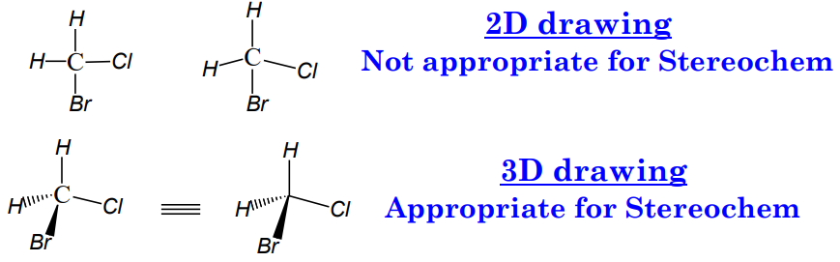
STEREOCHEMISTRY
The study of the arrangement of atoms of a mol. in space
And effects of these arrangements on their phys&chem props
You could also think of it as the study of Stereoisomerism

Slide 20
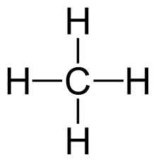
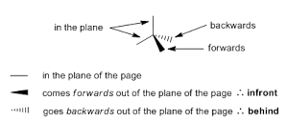
STEREOCHEMISTRY: Notation
Dash = Pointing away from you
Wedge = Pointing towards you
Line = On the same plane of the paper/screen

Slide 21
STEREOISOMERISM: Terms
Chirality is the property of an object (e.g. a molecule) of being non-superimposable on another object that is its mirror image
It is characterized by an atom e.g. Carbon which has four different groups bound to it so that its mirror image is nonsuperimposable
Hence, any mirror images of a chiral compound will be nonsuperimposable on each other
A stereogenic center is another name for a chiral centre

Slide 22
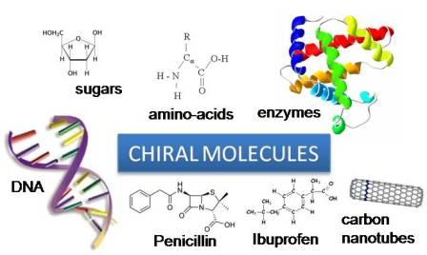
IMPORTANT CHIRAL MOLECULES

Slide 23
STEREOCHEMISTRY: Importance
The study of stereochemistry is important because…
The stereochemistry of two different isomers of the same compound can affect their
Physical properties
Chemistry properties
Hence, their chemical reactivities & biological functions can be very different!

Slide 24
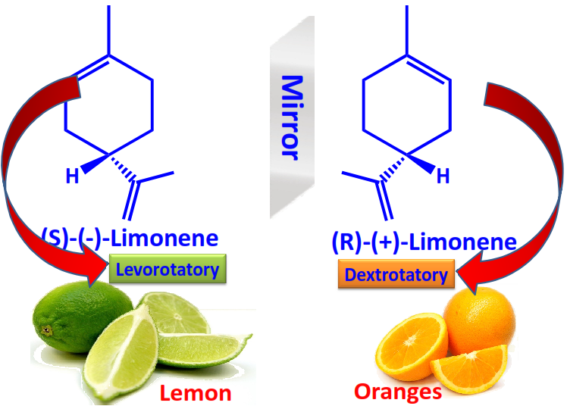
STEREOCHEMISTRY: Importance
A

Slide 25
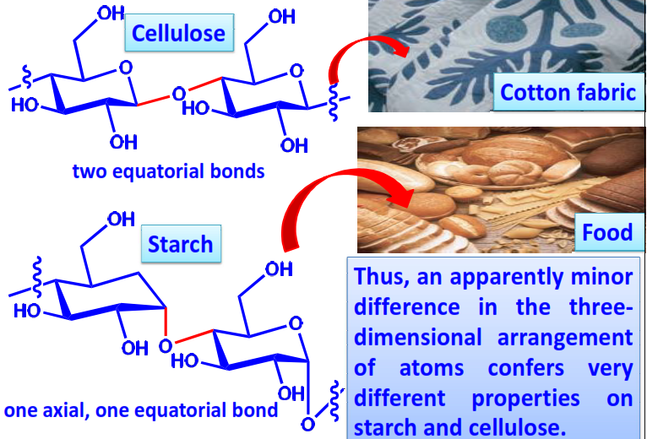
STEREOCHEMISTRY: Importance
A

Slide 26
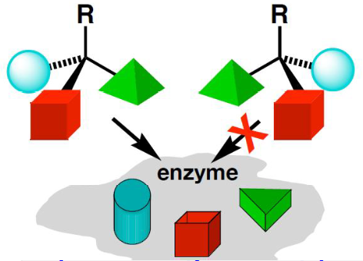
STEREOCHEMISTRY: Importance
Many biological processes such as
Drug action
Enxyme catalysis
Metabolism and catabolism, etc
Depend on the
Structure Activity Relationships (SAR) of molecules to receptors
i.e. They fuction via a Lock and Key mechanism

Slide 27
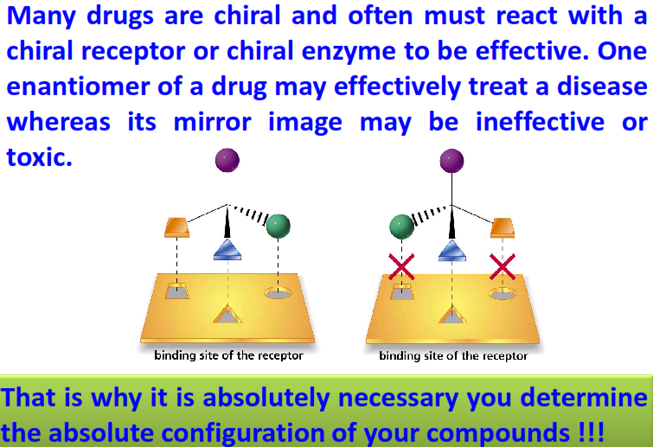
STEREOCHEMISTRY: Importance

Slide 28
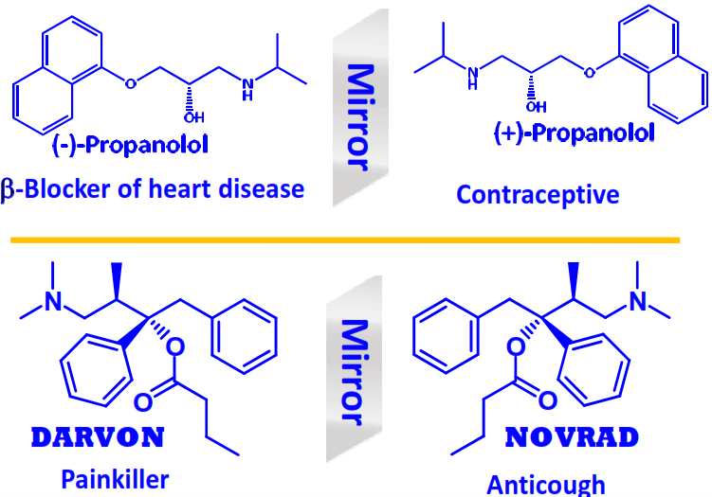
STEREOCHEMISTRY: Importance
A

Slide 29
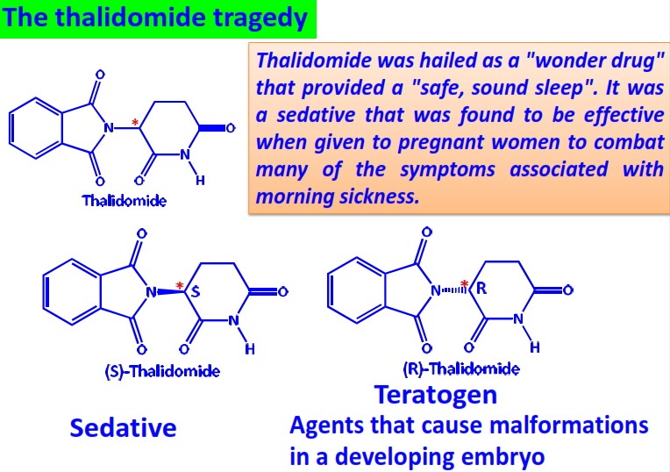
STEREOCHEMISTRY: Importance

Slide 30

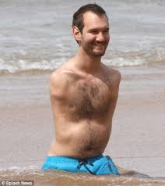
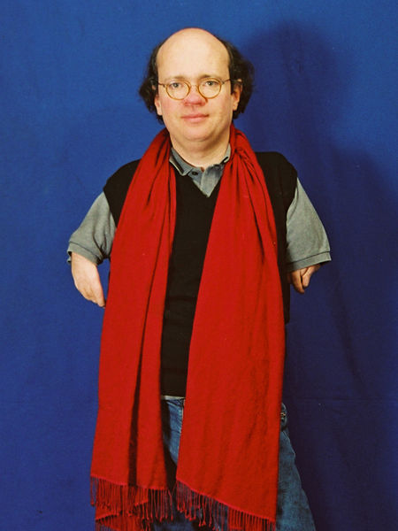
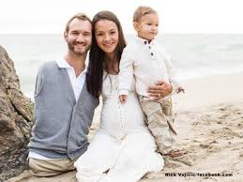

THALIDOMIDE EFFECT
Nick Vujicic
Niko von Glasow: German filmaker

Slide 31
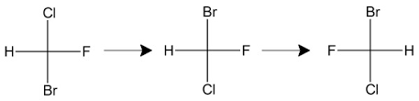
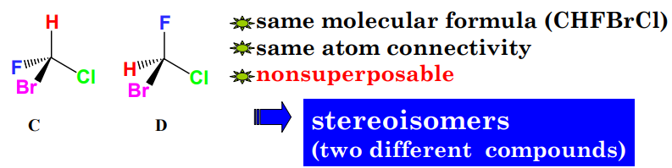
STEREOISOMERISM
Consider CHFBrCl

Slide 32
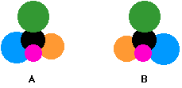
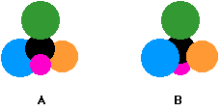
STEREOISOMERISM
Stereoisomerism is the existence of compounds which have…
Same formula (e.g. CHFBrCl)
Same linkage (H, F, Br and Cl all linked to C)
Different spatial arrangements/orientations (clockwise, anticlockwise, etc.)
Two types:
Configurational and
Conformational

Slide 33
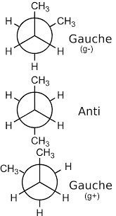
STEREOISOMERISM: Types
CONFORMATINAL ISOMERISM
The conformation of a molecule is the precise spatial arrangement of the groups of atoms in it as a result of rotation about single bonds
Infinite number of possible conformations
However, only those conformational isomers possessing energy minima (e.g. anti (180⁰), syn (0⁰), gauche (60⁰) etc) are denoted conformers

Slide 34
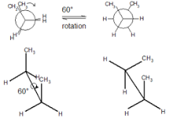
CONFORMATIONAL ISOMERISM
Consider the example of
CH₃CH₂CH₂CH₃ (Butane)
Viewing the molecule through Carbon2-Carbon3
Imagine C₂-C₃ bond rotating
There are a couple of possible conformers

Slide 35
CONFORMATIONAL ISOMERISM
Q
Now try 2-Bromobutane viewing through C₂-C₃

Slide 36

QUESTIONS???

Slide 37
STEREOISOMERISM: Types
CONFIGURATIONAL ISOMERISM
The configuration of a molecule is the spatial arrangement of atoms or groups of atoms in the molecule that DOES NOT DEPEND on rotation about any single bond
Two types of configurational isomerism
Cis-Trans (or Geometric) isomerism &
Optical isomerism

Slide 38
CIS-TRANS (GEOMETRIC) ISOMERISM
A type of Configurational Isomerism where…
Restriction to rotation is because of A DOUBLE BOND or RING SYSTEM
Hence, a double bond or ring must be present in a molecule before it can exhibit cis-trans isomerism
Isomers are denoted by the relative stereochemistry (cis or trans) of their chiral centres

Slide 39
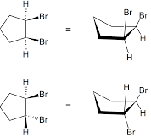
CIS-TRANS (GEOMETRIC) ISOMERISM
Relative Stereochemistry: Refers to the stereochemistry of a chiral centre w.r.t another chiral centre on same molecule
E.g. Cis and Trans configurations
Two substituents are called Cis to one other if they’re pointing in the same direction
Two substituents are trans to one another if they’re pointing in opposite directions
This is the basis of CIS-TRANS ISOMERISM
Cis-1,2-dibromocyclopentane
Trans-1,2-dibromocyclopentane

Slide 40
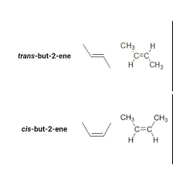
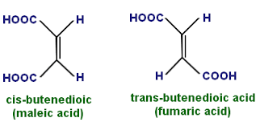
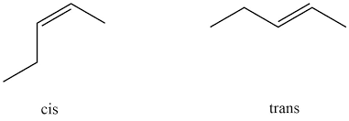
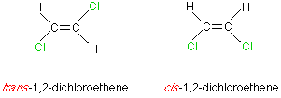
GEOMETRIC (CIS-TRANS) ISOMERISM
d

Slide 41
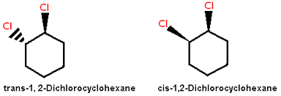
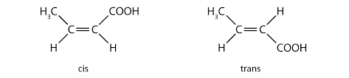
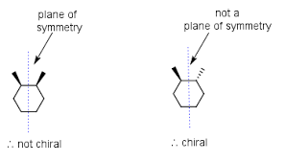
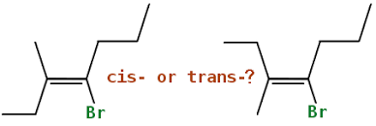
GEOMETRIC (CIS-TRANS) ISOMERISM
d

Slide 42
E/Z NUMENCLATURE IN CIS/TRANS ISO
E/Z notation is used to denote relative stereochemistry
Where
E === Trans
Z === Cis
The determination of E or Z follows the Cahn-Ingold-Prelog (CIP) rules

Slide 43
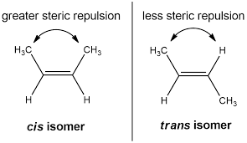
CIS/TRANS ISOMERISM: Conclusion
Cis/trans Isomers vary one from another in their physical and chemical properties and hence must be treated carefully
These differences are mostly due to the differences in steric interaction between the substituents
The greater the steric repulsion, the higher the energy of the molecule (lesser stability)

Slide 44
QUESTIONS???

Slide 45
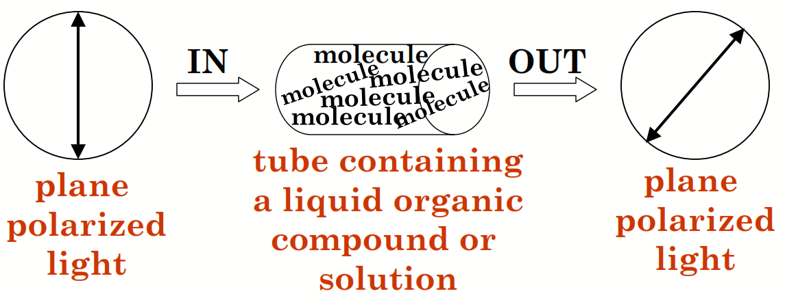
STEREOISOMERISM: Terms
Optical activity: The ability of chiral substances to rotate the plane of polarized light by a specific angle
Dextrorotatory: Ability of chiral substances to rotate the plane of polarized light to the RIGHT direction. Denoted (+)
Levorotatory: Ability of chiral substances to rotate the plane of polarized light to the LEFT direction. Denoted (-)

Slide 46
CHM 103 ORGANIC CHEMSTRY I
Department of Chemical Sciences
Faculty of Science and Technology
Bingham University, Karu
Course Lecturer: Joseph C. Oguegbulu
Joseph.oguegbulu@binghamuni.edu.ng

Slide 47
LECTURE VII
OPTICAL ISOMERISM
ENANTIOMERISM
DIASTEREOMERISM
MESOMERS
RACEMIC MIXTURES

Slide 48
OBJECTIVES: At the end, you should be able to…
Appreciate the 3-D orientation of atoms in a stereoisomer
Explain chirality and optical isomerism with e.g.
Differentiate between enantiomers and diastereomers
Explain Mesomers, recemisation, etc

Slide 49
OPTICAL ISOMERISM
Optical activity: The ability of chiral substances to rotate the plane of polarized light by a specific angle
Hence Optical Isomers are stereoisomers that have opposite optical activities. i.e. one is dextrorotatory; the other, levorotatory
Types of Optical Isomerisms; Enantiomerism & Diastereomerism

Slide 50
STEREOISOMERISM: Terms
Chirality is the property of an object (e.g. a molecule) of being non-superimposable on another object that is its mirror image
It is characterized by an atom e.g. Carbon which has four different groups bound to it so that its mirror image is nonsuperimposable
Hence, any mirror images of a chiral compound will be nonsuperimposable on each other
A stereogenic center is another name for a chiral centre

Slide 51
OPTICAL ISOMERISM: Types
Enantiomerism: Existence of stereoisomers that are nonsuperimposable mirror images
Diastereomers: Simply put; stereoisomers that are not enantiomers
Compounds with multiple chiral centres can exhibit both enantiomerism and diastereomerism
But compounds with a single chiral centre can only exhibit Enantiomers

Slide 52
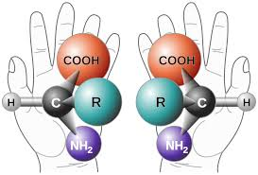
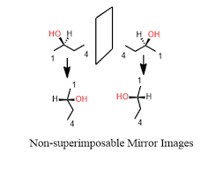
ENANTIOMERISM
Stereoisomers that are non-superimposable mirror images of each other
Think of your Left & Right hands
They are non-superimposable
They are mirror images
Every pair of enantiomer have the same physical props but different optical rotations

Slide 53
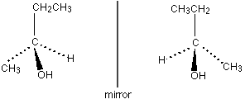


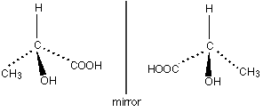
ENANTIOMERS: Examples
Butanol
Lactic acid (2-hydroxypropanoic acid)

Slide 54
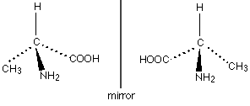

ENANTIOMERS: Examples
Alanine (2-Aminopropanoic acid)
In protein/carbohydrate chemistry, R corresponds to D, while S corresponds to L

Slide 55
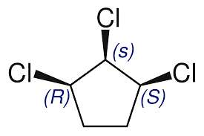
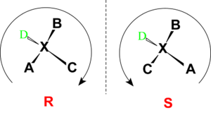
R/S NOTATION (ABSOLUTE STEREOCHEM.)
Absolute stereochemistry: Refers to the precise arrangement of substituents at a chrial centre
E/Z notation denotes relative stereochemistry
R/S notation denotes absolute stereochemistry
R (Rectus) OR S (Sinister)
It is determined by the Cahn-Ingold-Prelog rules
Can also be determined by X-ray Crystallography

Slide 56
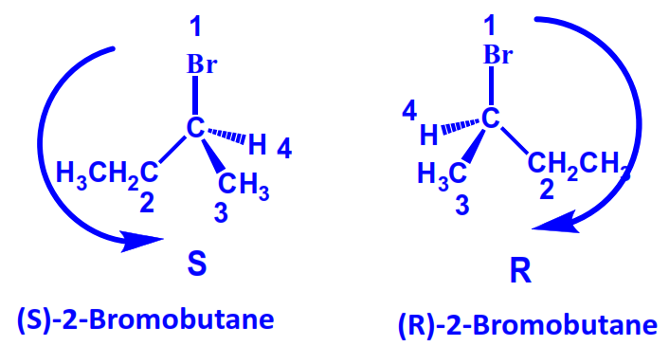

ABSOLUTE CONFIG vs OPTICAL ROTATION
Optical Rotation [α]^{t}_{D} is the angle through which the plane of polarized light that passes through an optically active substance is rotated
It can only be determined experimentally
Note: The absolute stereochemistry (R/S) of a chiral centre is NOT in any way related to its optical activity (-) or (+)

Slide 57

ENANT: Absolute config vs Optical Rotation
Each enantiomer is identifiable by its absolute config (R/S) in its name
Any of the Isomers can be (+) or (-) rotatory in terms of optical activity
Hence you could have R-(+) or R-(-) or S-(+) or S-(-)

Slide 58
QUESTIONS???

Slide 59
DIASTEREOMERISM
Simply put; they are stereoisomers that are not enantiomers
Can only exists in molecules with multiple chiral centers
i.e. Compounds with multiple chiral centres can exhibit both enantiomerism and diastereomerism
But compounds with a single chiral centre can only exhibit Enantiomerism
Unlike Enantiomers, each diastereomer would have different physical & chemical properties from the others

Slide 60
DIASTEREOMERISM
Given a molecule with multiple chiral centres, how do you know..
Which stereoisomers are diastereomers?
Which ones are just enantiomers?
It would be cumbersome to start checking for superimposability non-superimposability, mirror images or non-mirror images, etc
*
*
*

Slide 61
DIASTEREOMERISM
Simple: LOOK AT THEIR CHIRAL CENTRES IN THE TWO MOLECULES…
If all chiral centres are reversed == Enantiomers
If some chiral centres are reversed and some retained == Diastereomers
*
*
*

Slide 62

DIASTEREOMERISM
*
*
If all chiral centres are reversed == Enantiomer
If some chiral centres are reversed and some retained == Diastereomer
*

Slide 63
QUESTIONS???

Slide 64




MESOMERS
Mesomers are compounds which have chiral centres but DO NOT exhibit optical activity
Due to the presence of an internal plane of symmetry in molecule
In such case the optical activities of the 2 chiral centres cancel out

Slide 65
RACEMIC MIXTURES
A Racemic mixture is a 50/50 mixture of both ‘R’ and ‘S’ enantiomers of same molecule
Hence NO optical activity will be exhibited by such a mixture
This usually occurs after lab synthesis of chiral compounds
RACEMISATION: The process of separating a racemic mixture
An enantiomerically pure substance is one which contains only one enantiomer of the molecule

Slide 66
RACEMIC MIXTURES
Specific Rotation:

Slide 67
STEREOCHEMISTRY: Importance

Slide 68
THALIDOMIDE EFFECT
Nick Vujicic
Niko von Glasow: German filmaker

